Slide 1



1
03
Agile
Development
z

Slide 2
2
z
Today’s
Lesson
Extreme
Programming
Other Agile
Process
Models
Agility
Agile Process

Slide 3
3
z
The Agile Manifesto
▪ In 2001, the “Agile Alliance” signed the “Manifesto for Agile
Software Development.” It stated:
▪ We are uncovering better ways of developing software by doing it
and helping others do it. Through this work we have come to value:
▪ Individuals and interactions over processes and tools
▪ Working software over comprehensive documentation
▪ Customer collaboration over contract negotiation
▪ Responding to change over following a plan

Slide 4
4
z
What is Agility?
Agile software engineering
development guidelines
▪ The philosophy encourages:
▪ Customer satisfaction
combines a philosophy and a set of
▪
The development guidelines stress:
▪
Delivery over analysis and design
▪ Early incremental delivery
▪
Active and continuous
communication between developers and customers
▪ Small, highly motivated teams
▪ Informal methods
▪ Minimal work products
▪ Development simplicity

Slide 5




5
z
What is Agility?
Team structures and
attitudes that make
communication among team
members more facile
Rapid delivery of operational
software and de-emphasizes
the importance of
intermediate work products
It adopts the customer as a
part of the development team
and works to eliminate the
“us and them” attitude
It recognizes that planning in
an uncertain world has its
limits and that a project plan
must be flexible.

Slide 6
6
z
What is Agility?
▪ To
successfully apply agility to any software process:
Process should allow the project team to adapt and streamline tasks
▪
▪
Fluidity in planning
▪
Focus on the most essential work products
▪
Emphasize an incremental delivery strategy

Slide 7
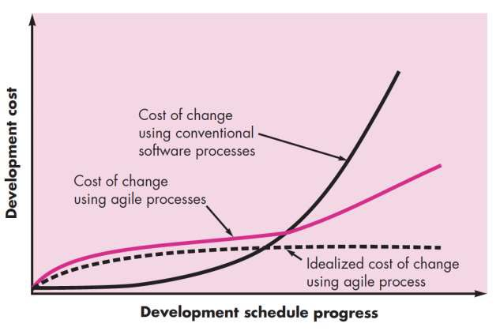
7
z
Agility and the Cost of Change

Slide 8
8
z
The Agile Process
▪ Any agile software process addresses a number of key
assumptions about the majority of software projects:
1. It is difficult to predict in advance which software requirements
persist and which will change.
will
2. For many types of software, design and construction are
interleaved.
3. Analysis, design, construction, and testing are not as predictable
as we might like.

Slide 9
9
z
The
Agile
Process
▪ Given these three assumptions, how do we create
that can manage unpredictability?
a process

Slide 10






10
z
12 Agility Principles
Customer satisfaction by early and continuous delivery of valuable software.
Welcome changing requirements, even in late development.
Deliver working software frequently (weeks rather than months).
Close, daily cooperation between business people and developers.
Projects are built around motivated individuals, who should be trusted.
Face-to-face conversation is the best form of communication.

Slide 11






11
z
12 Agility Principles
Working software is the primary measure of progress.
Sustainable development, able to maintain a constant pace.
Continuous attention to technical excellence and good design.
Simplicity—the art of maximizing the amount of work not done—is essential.
Best architectures, requirements, and designs emerge from self-organizing teams.
Regularly, the team reflects on how to become more effective, and adjusts accordingly.

Slide 12
12
z
Human Factors
▪ Proponents of agile software development take great pains to
emphasize the importance of “people factors.”
▪ If members of the software team are to drive the characteristics
of the process that is applied to build software, a number of key
traits must exist among the people on an agile team and the
team itself

Slide 13
z
Human Factors
Competence
Common Focus
Collaboration
Decision-making ability
Fuzzy problem- solving ability
Mutual trust and respect

Slide 14
14
z
Extreme Programming (XP)
A set of five values are defined that establish a foundation
for
all
work performed as
part
of
XP:
▪ Communication
▪ Simplicity
▪ Feedback
▪
Courage / Discipline
Respect
▪
▪
Each of these
values
is used as
a driver for specific XP activities,
actions, and tasks.

Slide 15
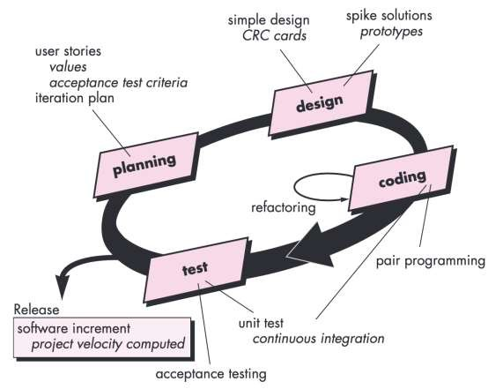
15
z
The XP
Process
An object-oriented
approach is used as its
preferred development
paradigm and
encompasses a set of
rules and practices that
occur within the context of
four framework activities:
planning, design, coding,
and testing.

Slide 16
16
z
The
XP
Process
Planning
▪ Listening - a requirements gathering activity
▪ Creation of a set of “stories” (also called user stories)
▪ Each story is placed on an index card and assigned a priority value
▪ XP team then assess each story and assign a cost
▪ Commitment (agreement on stories to be included, delivery date,
and other project matters) is made for a release
▪ Project velocity (the number of customer stories implemented
during the first release) is computed.

Slide 17
17
z
The XP Process
Design
▪
▪
XP design rigorously follows the KIS (keep it simple) principle
XP encourages the use of CRC (class-responsibility-collaborator) cards as an effective mechanism for thinking about the software in O-O context.
In case of a difficult design problem a spike solution, the design prototype is implemented and evaluated.
The intent is to lower risk when true implementation starts
A central notion in XP is that design occurs both before and after coding commences. Refactoring means that design occurs continuously as the system is constructed.
an
▪
▪

Slide 18
18
z
The XP
Process
Coding
▪ Unit tests are developed after story-creation before coding begins
▪ Once the code is complete, it can be unit-tested immediately,
thereby providing instantaneous feedback to the developers
▪ Pair programming: real-time problem-solving and quality
assurance
▪ Continuous Integration: helps to avoid compatibility and interfacing problems and to uncover errors early

Slide 19
19
z
The XP Process
Testing
▪ Unit tests: Should be automated as
be used repeatedly
▪ Focus on classes
mush
as
possible
so
they
can
▪ Done by XP Team
▪ Acceptance tests: customer tests
▪ Focus on overall system features and functionality
▪ Done by customers

Slide 20

20
z
Industrial
XP
Have you
heard of
Industrial XP?
How does it
differ from
XP?

Slide 21
21
z
Other Agile Process Models
▪ Many other agile process models have been proposed and are
in use across the industry. Among the most common are:
▪ Adaptive Software Development (ASD)
▪ Scrum
▪ Dynamic Systems Development Method (DSDM)

Slide 22
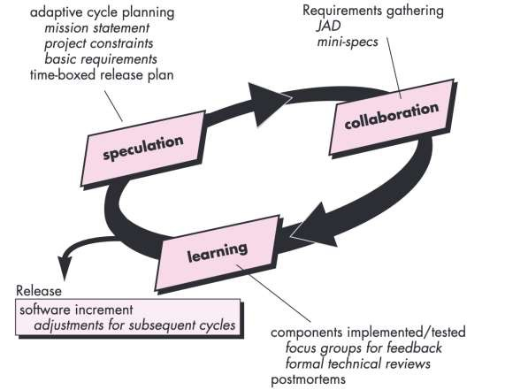
22
z
Adaptive
Software Development (ASD)
• A technique for
building complex software.
• The philosophy
focuses on human
collaboration and
team self-
organization

Slide 23
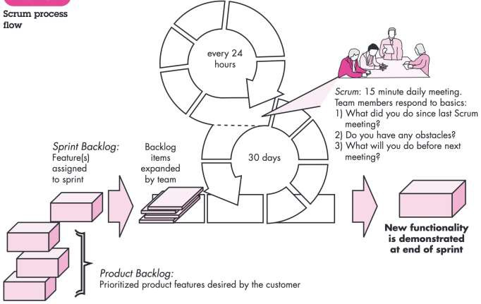
23
z
Scrum
Scrum framework
activities: requirements,
analysis, design,
evolution, and delivery.
Within each framework
activity, work tasks occur within a process pattern called a sprint
▪ Backlog
▪
Sprints
▪ Scrum meetings
▪ Scrum master
▪ Demos

Slide 24
24
z
Dynamic
Systems
Development Method
(DSDM)
▪ It provides a framework for building and maintaining systems
which meet tight time constraints through the use of incremental
prototyping in a controlled project environment
▪ Philosophy—80 percent of an application can be delivered in
20 percent of the time it would take to deliver the complete application

Slide 25
25
z
DSDM Life
cycle
activities
Feasibility study
• Basic business requirements and constraints
Business study
• Functional and information requirements
Functional model iteration
• Produces a set of incremental prototypes
Design and build iteration
• Ensure that each functional model has been well engineered
Implementation
• Places the software into the operational environment

Slide 26
26
z
Exercise
▪ Describe agility (for software projects) in your own words.
▪ Why does an iterative process make it easier to manage
change?
▪ Try to come up with one more “agility principle” that would help a
software engineering team become even more manoeuvrable

Slide 27
27
Any Questions?
The End
z

